Slide 1
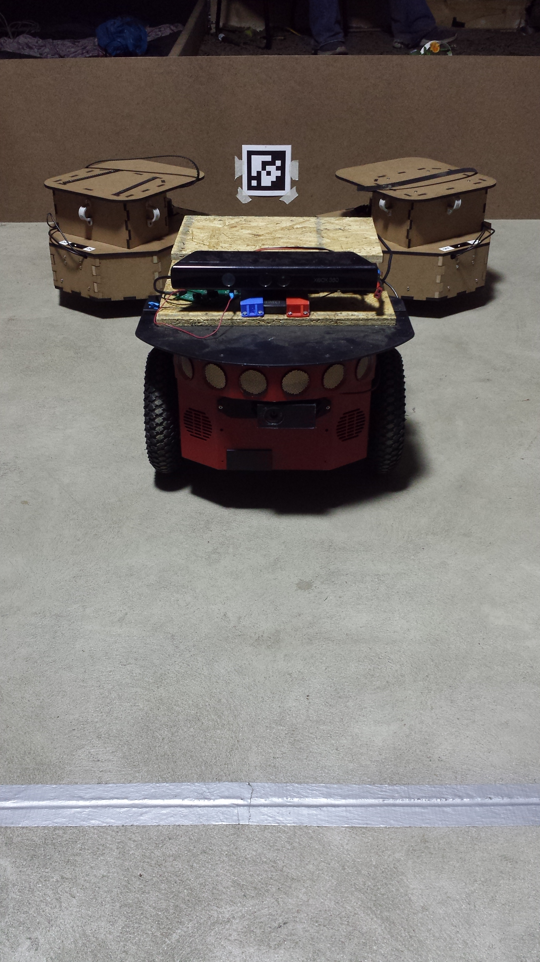
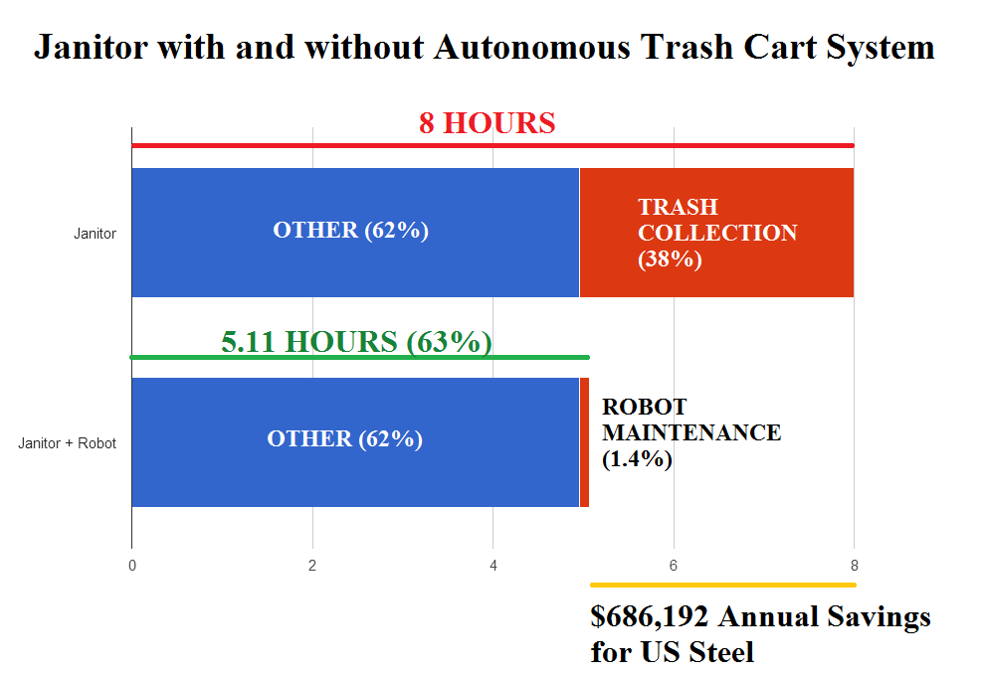
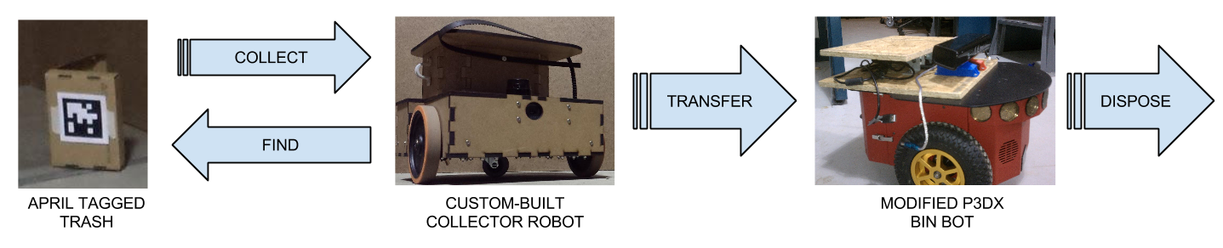
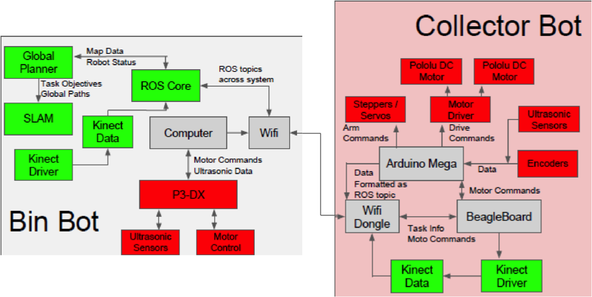
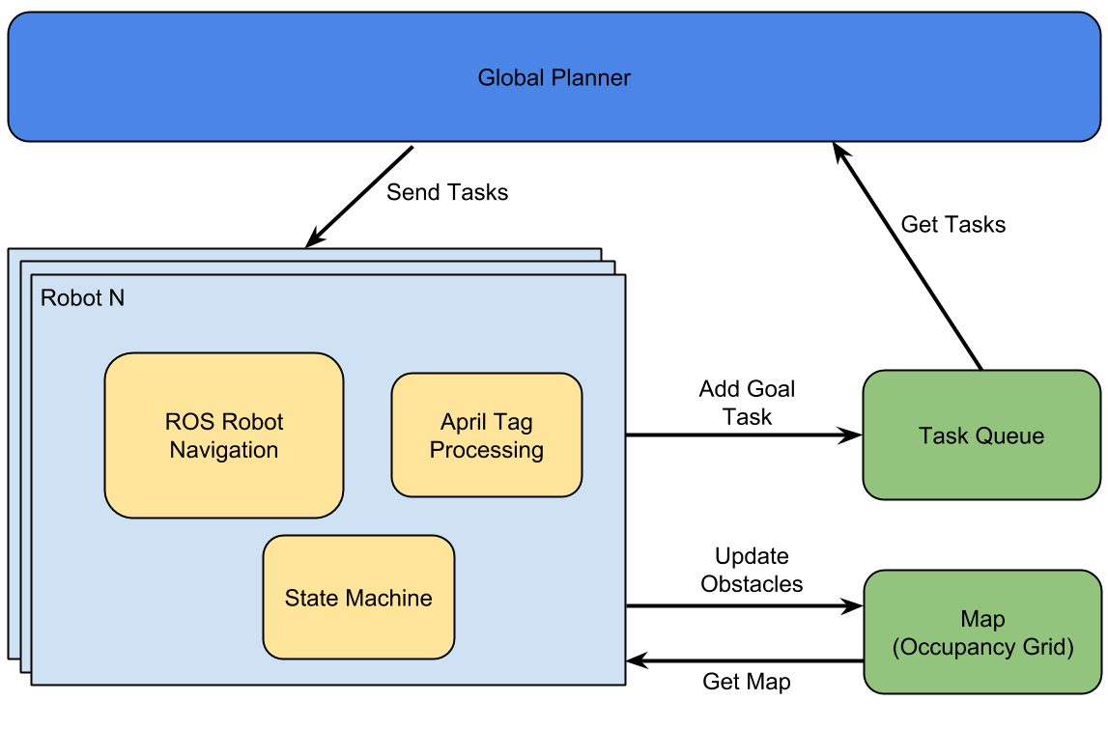
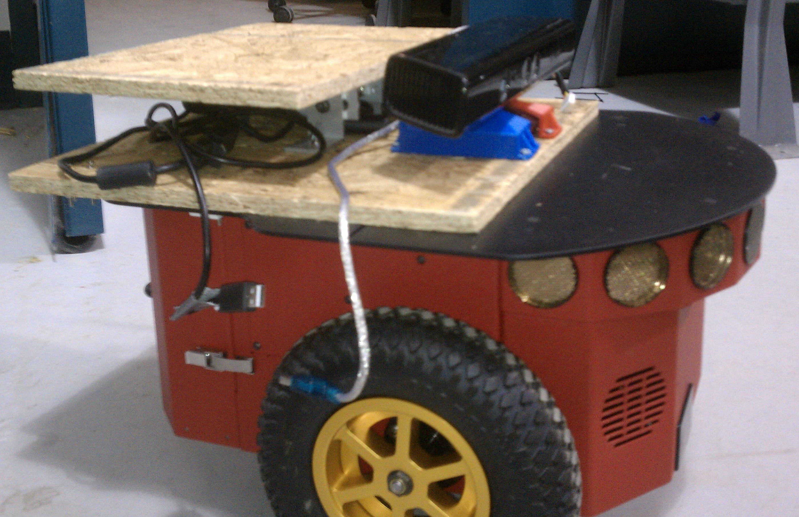
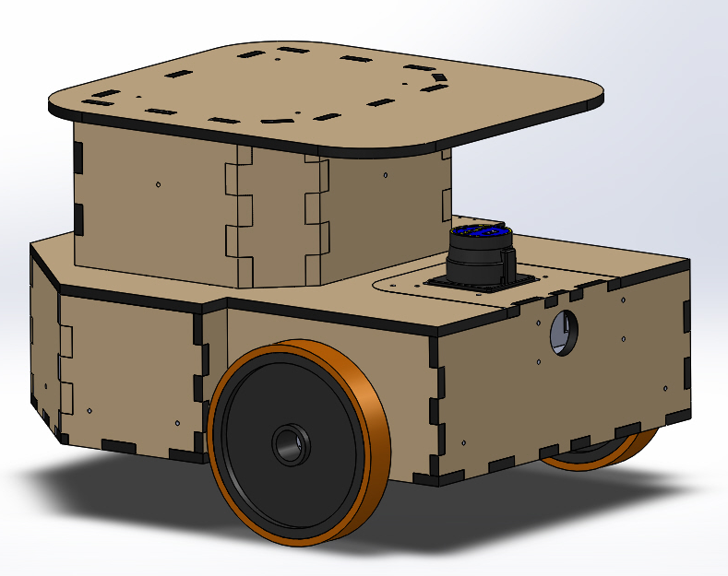
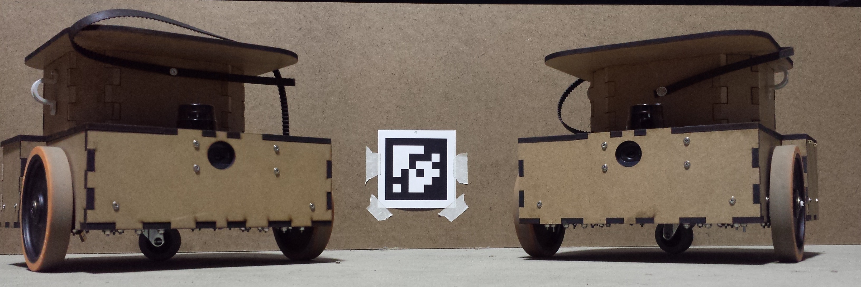
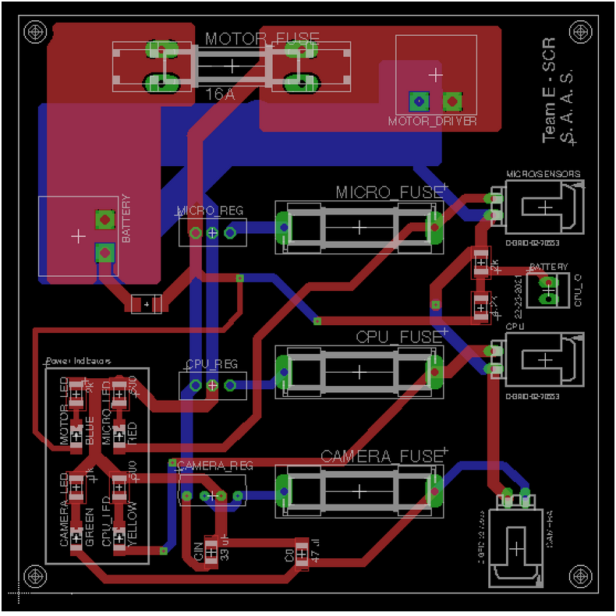
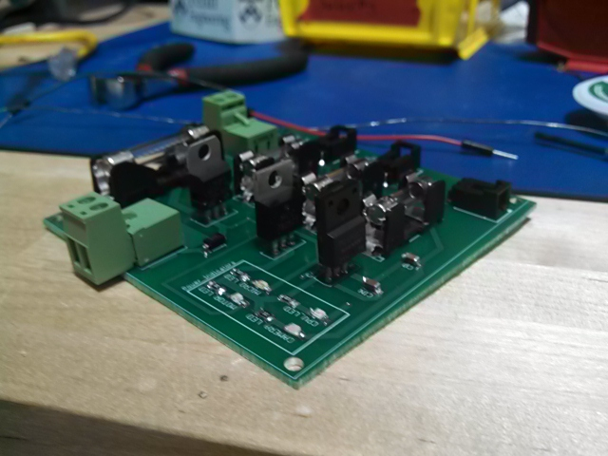
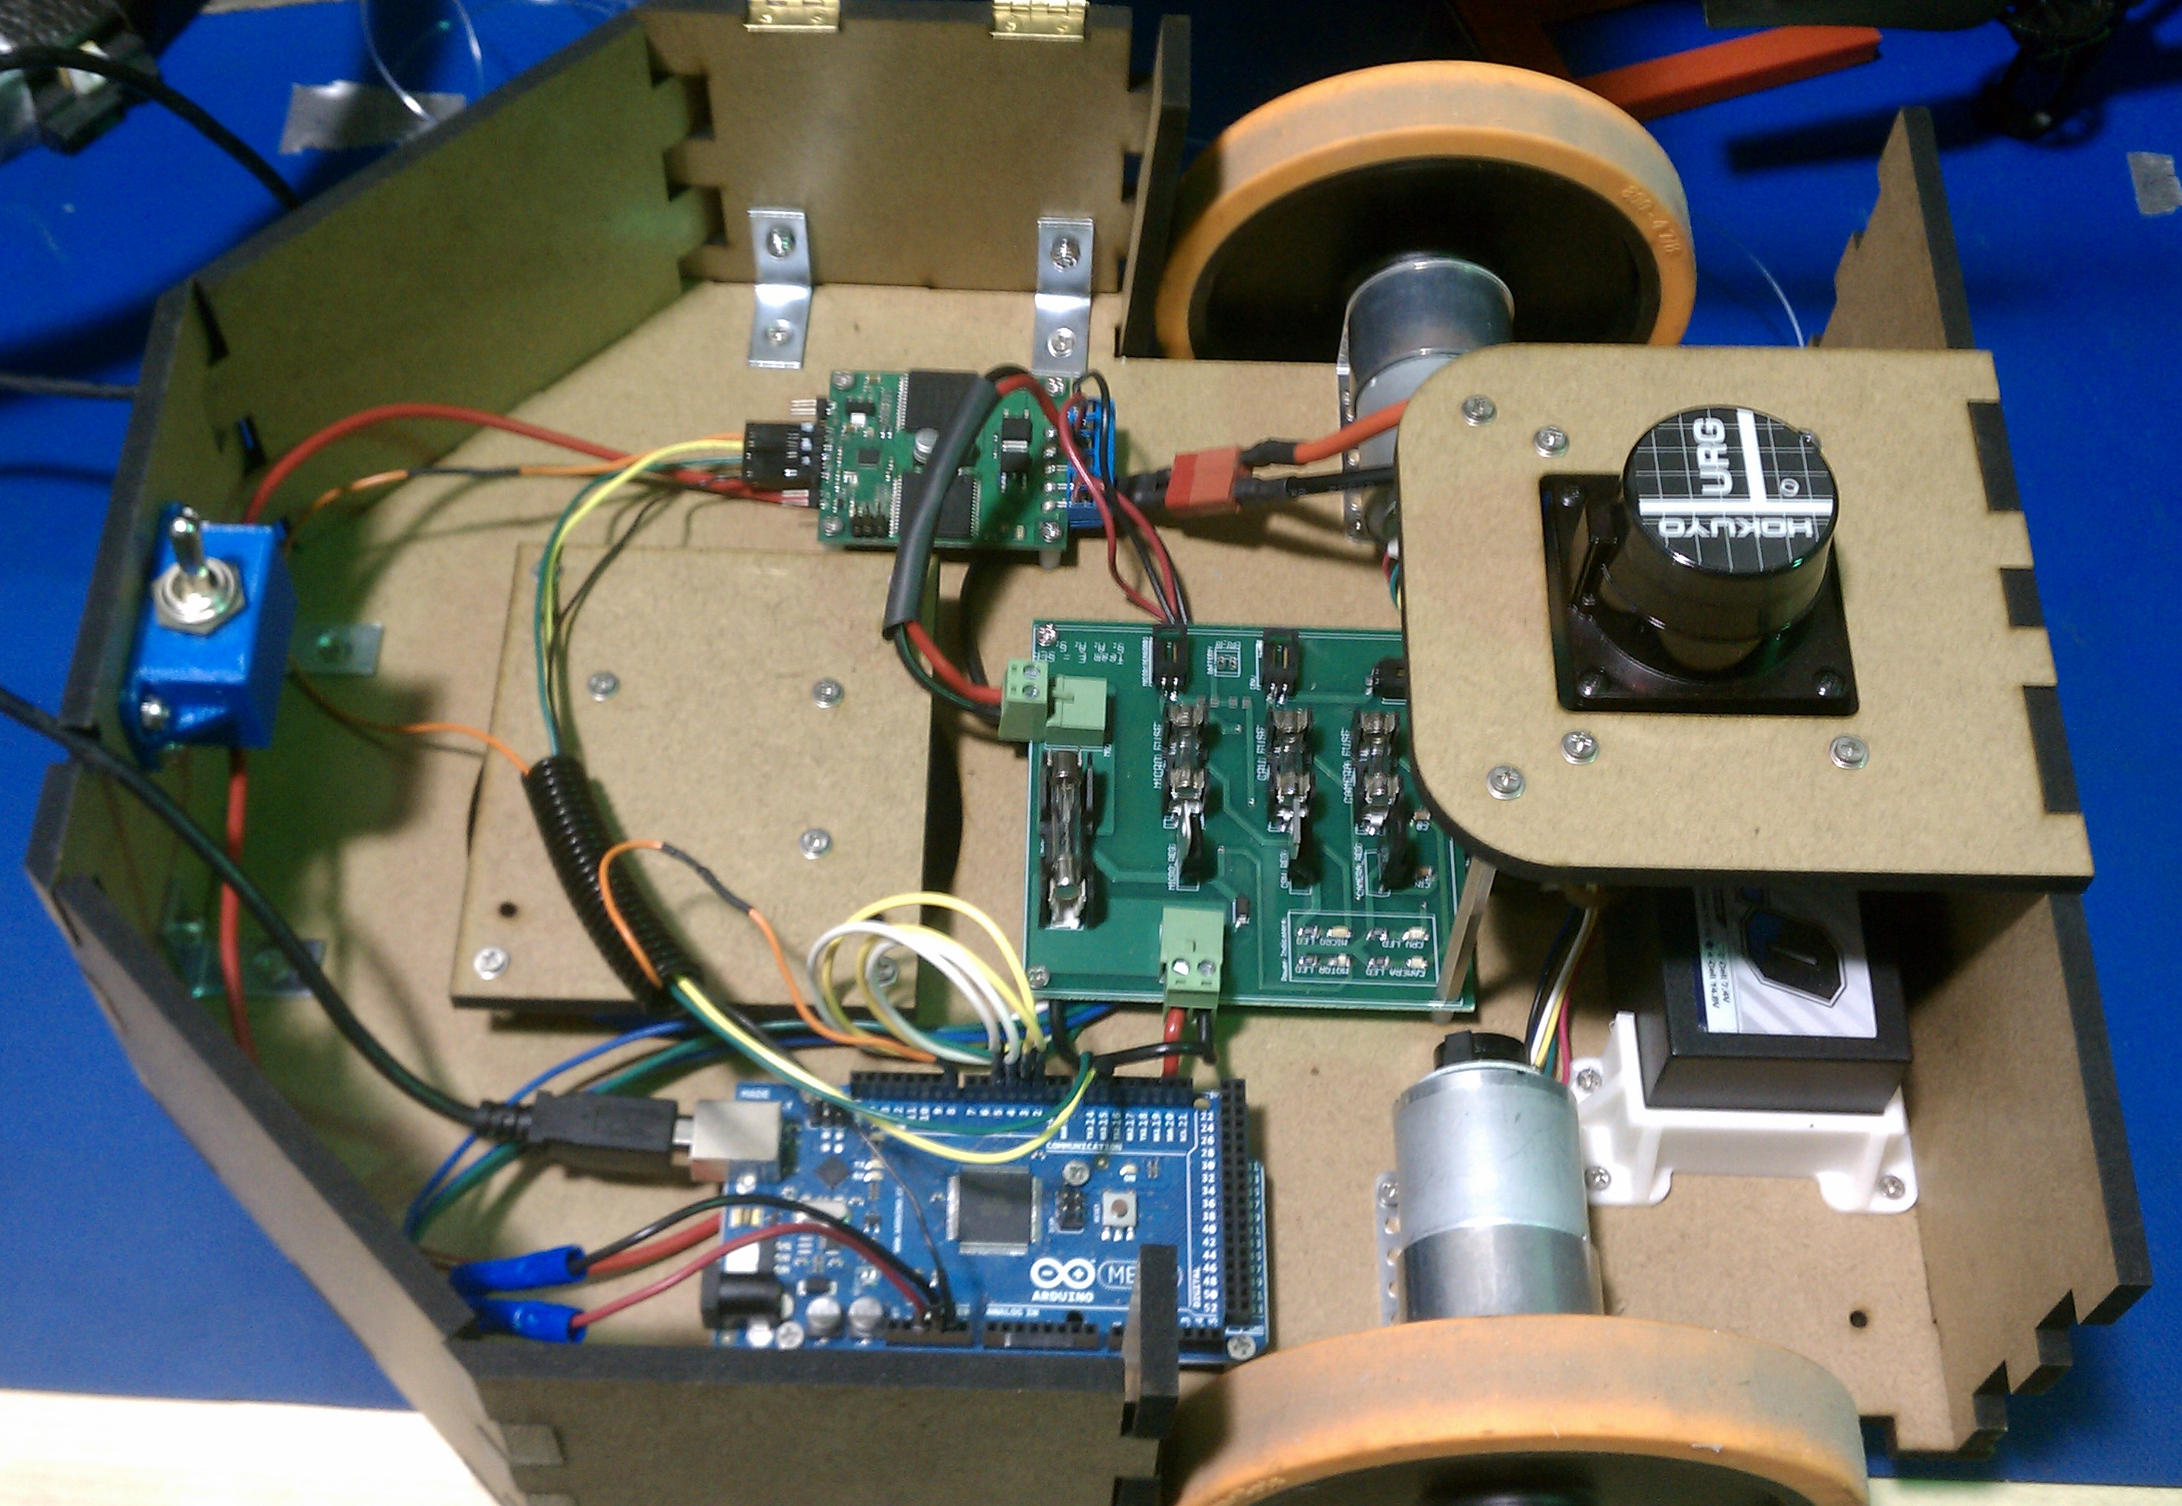
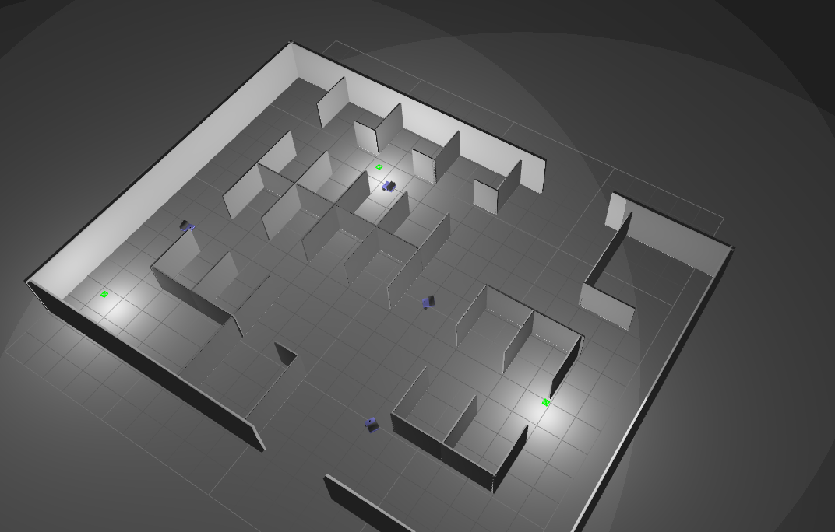
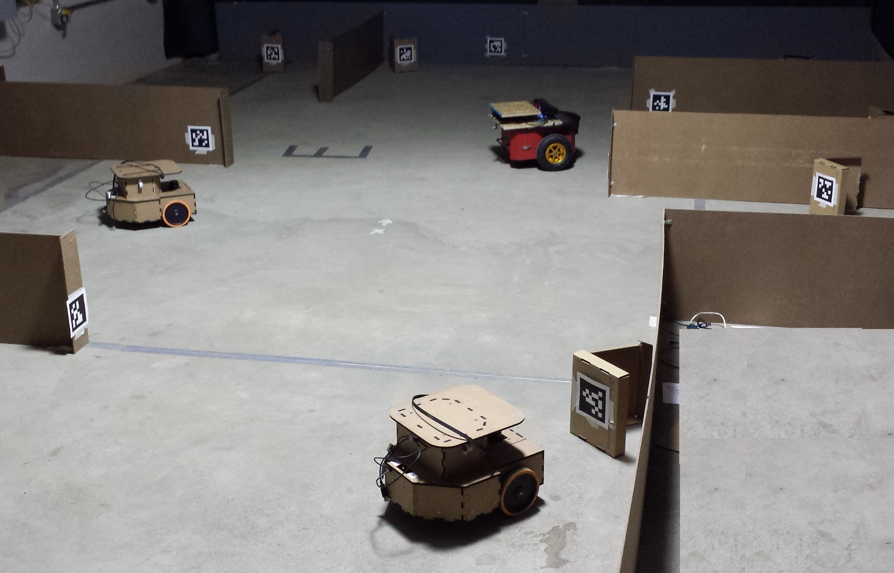
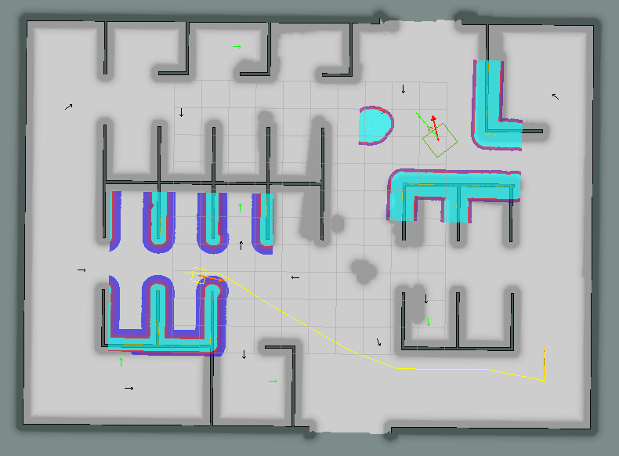
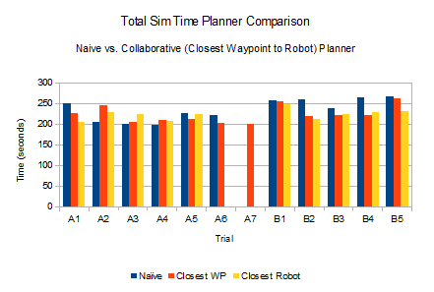
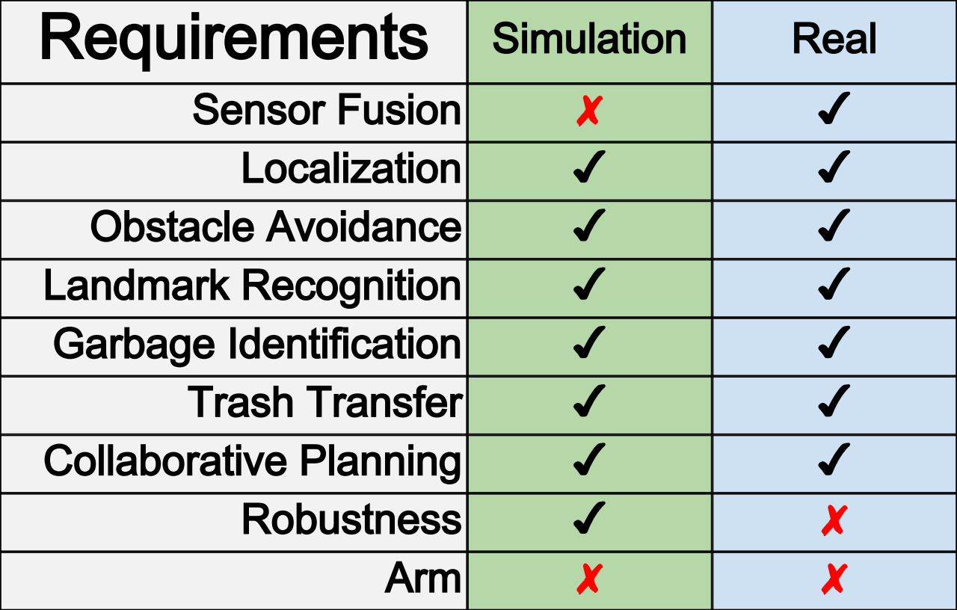
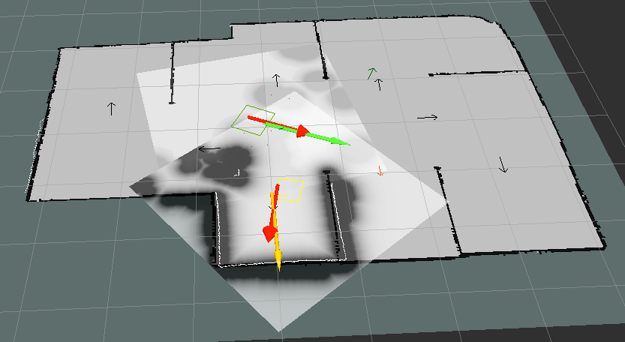
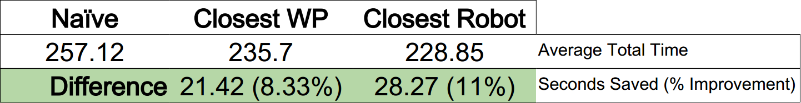
Multi-Robot Collaborative
Exploration and Navigation
Sam Ansari, Shawn Hanna, Aaron Nye, Alex Sher
Problem
Statement
Robots Forage Office
Cubicle Environments
to Assist in Trash
Removal
Approach
Collector Robots Search for AprilTags in the Environment representing Garbage, Collect, and then Aggregate the Garbage into Bin Robots
Conceptual Approach Used To Design System and Complete Task
Potential Cost Savings Opportunity
Software Design
The Team Designed Software to
Integrate With the ROS Navigation
Stack to Intelligently and
Efficiently Search an Environment
for AprilTags While Fusing Data
From Multiple Sensor Sources. The
State Of The Robots, Tasks, and
Trash Cans are Maintained by the
Global Planner.
Hardware
Design
A Modified P3-DX with
A Microsoft Kinect and
A Custom Mobile Base
Were Designed to Do
Carry Out the Task.
The Custom Robots were
Designed with the
Successes of the P3-DX
In mind.
System Physical Architecture
Electronics Design
Custom Electronics
Had to Be Designed to
Bring Power to All
On Board Subsystems
P3-DX with Custom Mount
Early CAD of Custom Robot
Two Final Custom Robots in Test Environment
Custom Electronics Solutions (From Left to Right): EAGLE Design of Custom PCB, Finished PCB, and Integration of PCB Into Custom Robot
Results
The Team Successfully Implemented The System
First in Simulation to Test Various Global
Planner Strategies and Parameters, as Well as
General System Feasibility. After Stability was
Reached In Simulation, the Team Integrated that
Software With the Hardware System for
Real World Testing and Application.
Simulation
Real
Gazebo Simulation Environment
Real Test Site Environment
Two Robot Simulation w/Paths & Costmaps
Planner Efficiency Improvements vs. Naïve
Summary of Requirements Performance
Visualization of Robot States in rViz for Real Test Site
Conclusions
The results from our tests show that significant performance gains can be achieved by using a collaborative planning approach to navigating and exploring partially known environments with multiple heterogeneous robots.
Thanks To
Alberto Speranzon and Julain Ryde –
United Technologies Research Center
John Dolan, Hagen Schempf, Ben Wasserman, Neil Abcouwer, Gerry Carlsson – MRSD Teaching Staff

